Slide 1

DATABASE COURSE 2023/2024
SESSION 6

Slide 2
SESSION 6
NULL TREATMENT
OR OPERATOR
DATA INSERTION FROM QUERIES

Slide 3
NULL TREATMENT
ONE NULL value checking Syntax
MySQL
SELECT IFNULL(Value1,Value2)
FROM table
Oracle
SELECT NVL(Value1,Value2)
FROM table

Slide 4
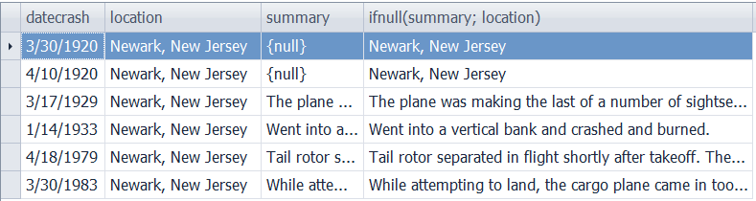
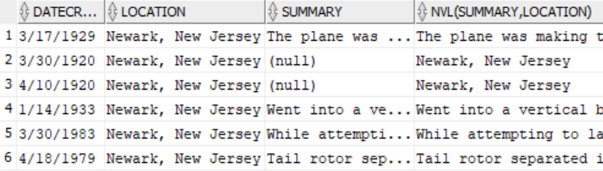
NULL TREATMENT
ONE NULL value checking Example
BBDD/User: airplanecrashes
MySQL
SELECT datecrash, location, summary,
IFNULL(summary, location)
FROM crash
WHERE location = 'Newark, New Jersey';
Oracle
SELECT datecrash, location, summary,
NVL(summary, location)
FROM crash
WHERE location = 'Newark, New Jersey';

Slide 5
NULL TREATMENT
SEVERAL NULL values checking Syntax
MySQL/Oracle
SELECT COALESCE(Field1,Field2,Field3)
FROM table
WHERE Field1 = Value1
NOTE: COALESCE looks for the first NOT NULL argument.

Slide 6

NULL TREATMENT
SEVERAL NULL values checking example
BBDD/User: airplanecrashes
MySQL/ Oracle
SELECT summary, location, operator,
COALESCE(summary, location, operator)
FROM crash WHERE type = 'Junkers JU-53/3m';

Slide 7

NULL TREATMENT
SEVERAL NULL values checking example
BBDD/User: airplanecrashes
MySQL/ Oracle
SELECT summary, location, operator,
COALESCE(summary, location, 'No detail')
FROM crash WHERE type = 'Junkers JU-53/3m'

Slide 8
NULL TREATMENT
IS NULL/IS NOT NULL Syntax
MySQL/Oracle
SELECT Field1,Field2,Field3 FROM table WHERE Field1 IS NULL
SELECT Field1,Field2,Field3 FROM table WHERE Field1 IS NOT NULL
Notes:
Comparisson with “= NULL” makes a “NOT TRUE”
So we have to use “IS NULL”

Slide 9
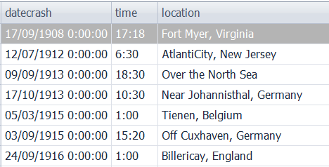
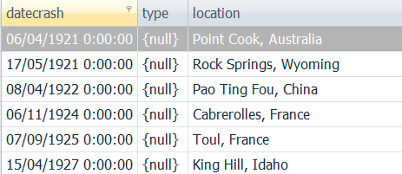
NULL TREATMENT
IS NULL/IS NOT NULL Example
BBDD/User: airplanecrashes
MySQL/Oracle
SELECT datecrash, time, location
FROM crash
WHERE time IS NOT NULL;
MySQL/Oracle
SELECT datecrash, type, location
FROM crash
WHERE type IS NULL;
Notes:
Comparisson with “= NULL” makes a “NOT TRUE”
So we have to use “IS NULL”

Slide 10
SESSION 6
NULL TREATMENT
OR OPERATOR
DATA INSERTION FROM QUERIES

Slide 11
OR OPERATOR
OR Syntax
MySQL/Oracle
SELECT *
FROM table
WHERE Field3 = Value3 AND
(Field1 = Value1 OR Field2 = Value2)

Slide 12
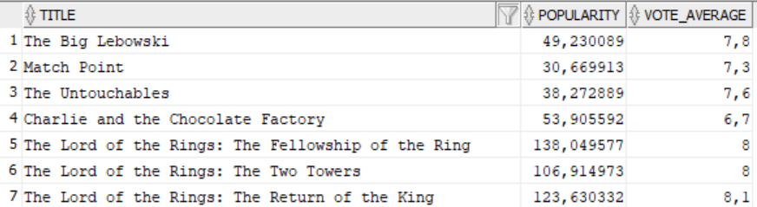
OR OPERATOR
OR Example
BBDD/User: moviebig
MySQL/Oracle
SELECT title , popularity, vote_average
FROM moviebig
WHERE popularity > 50 OR vote_average > 7

Slide 13
SESSION 6
NULL TREATMENT
OR OPERATOR
DATA INSERTION FROM QUERIES

Slide 14
DATA INSERTION FROM QUERIES
CREATE TABLE AS SELECT Syntax
MySQL/Oracle
CREATE TABLE NewTable AS
SELECT Field1,Field2,Field3,..., FieldN
FROM table
WHERE Field1 = Value1 AND
....

Slide 15
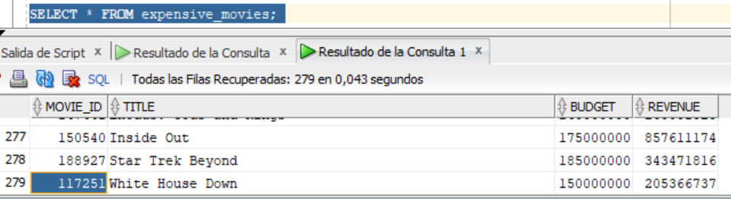
DATA INSERTION FROM QUERIES
CREATE TABLE AS SELECT Example
BBDD/User: moviebig
MySQL/Oracle
CREATE TABLE expensive_movies AS
SELECT movie_id, title, budget, revenue
FROM moviebig WHERE budget > 100000000;

Slide 16
DATA INSERTION FROM QUERIES
INSERT INTO SELECT Syntax
MySQL/Oracle
INSERT INTO ExistentTable
SELECT Field1,Field2,...,FieldN FROM table
WHERE Field1 = Value1 AND
...

Slide 17
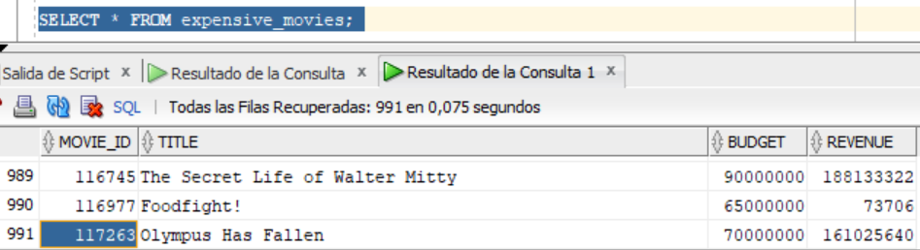
DATA INSERTION FROM QUERIES
INSERT INTO SELECT Example
BBDD/User: moviebig
MySQL/Oracle
INSERT INTO expensive_movies
SELECT movie_id, title, budget, revenue
FROM moviebig WHERE budget BETWEEN 50000000 AND 100000000;

